Slide 1
Mass energy

Slide 2






Mass energy
Question
Convert 1mg into energy
Solution
$$E=mc^{2}$$
$$⇒E=mc^{2}$$
$$={10}^{−3}∗{10}^{−3}∗{\left(3∗{10}^{8}\right)}^{2}$$
Einstein stated that mass and energy are different forms of the same fundamental entity, rather than one being stored in the other
$$=9∗{10}^{10}$$
Question
Convert 1amu into energy
Solution
$$E=mc^{2}$$
$$1amu=931MeV$$

Slide 3
Mass Defect

Slide 4








Mass Defect
Mass defect is the difference between the actual atomic mass and the predicted mass calculated by adding the mass of protons and neutrons present in the nucleus.
$$For →{}_{Z}^{A}X$$
Expected mass
$$m_{p}$$
$$Z$$
$$m_{n}$$
$$+(A−Z)$$
Real mass
$$m_{x}$$
$<$ Expected mass
$$ΔM=(Expected mass)−(Real mass)$$
$$ΔM=Zm_{p}+\left(A−Z\right)m_{n}−m_{x}$$

Slide 5
Binding energy

Slide 6


Binding energy
Mass defect is lost mass or say energy which is used to bind the protons and neutrons inside nucleus .
Binding energy
$$=ΔMc^{2}$$
Binding energy per nucleon
$$=\frac{ΔMc^{2}}{A}$$
OR say
Or say this is the amount of energy required to break this element into separate protons and neutron.
And this energy is Called
Binding energy

Slide 7





Question
Which of the following reaction is possible in nature
$${}_{0}^{1}n→{}_{1}^{1}p+{}_{−1}^{0}e$$
$${}_{1}^{1}p→{}_{0}^{1}n+{}_{1}^{0}e$$
Solution
$$m_{n}>m_{p}$$
$$n→p$$
This is possible in nature
$$p→n$$
This is not possible in nature outside nucleus
NOTE:
This is why free neutron is not stable

Slide 8
Question on energy

Slide 9












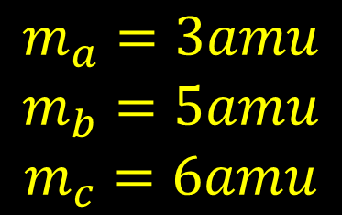


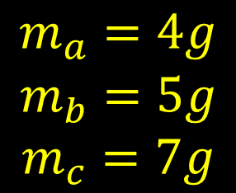


Finding energy emit in a reaction
$$A+B→C$$
$$A+B→C$$
$$\begin{matrix}m_{a}=4g \\ m_{b}=5g \\ m_{c}=7g\end{matrix}$$
$$\begin{matrix}m_{a}=3amu \\ m_{b}=5amu \\ m_{c}=6amu\end{matrix}$$
$$ΔM=$$
$$2g$$
$$ΔM=$$
$$2amu$$
$$E=$$
$$ΔMc^{2}$$
$$E=$$
$$2×931MeV$$
$$=2$$
$$×{10}^{−3}$$
$${(3×{10}^{8})}^{2}$$
$$=1862MeV$$
$$=18×$$
$${10}^{13}J$$

Slide 10


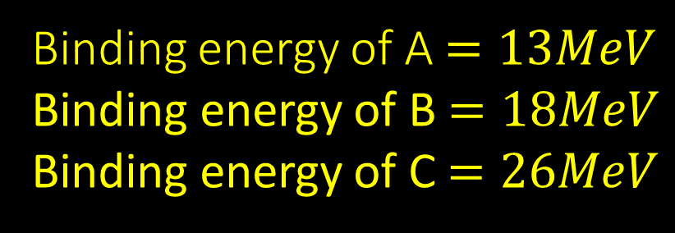
Question
Find energy emitted in the reaction
$$A+B→C$$
Binding energy of A $=13MeV$
Binding energy of B $=18MeV$
Binding energy of C $=26MeV$
Let’s Understand relation of Binding energy to Total energy
Solution
Wrong
If your answer is 5$MeV$ then it is

Slide 11
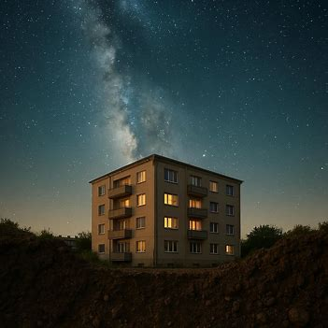
Which ball have greater energy
Which ball have greater Binding energy
1
1
2
2

Slide 12


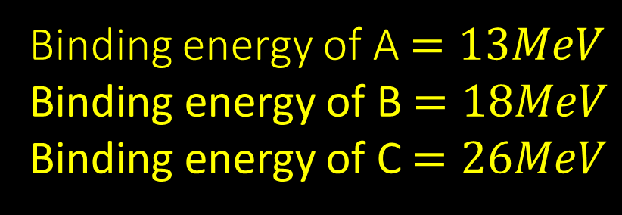
Question
Find energy emitted in the reaction
$$A+B→C$$
Binding energy of A $=13MeV$
Binding energy of B $=18MeV$
Binding energy of C $=26MeV$
Solution
Not Possible
This reaction is ______________
Increase
All reaction take place to __________ stability
Decrease
All reaction take place to _________ there stored energy
Also increase
For stability to increase binding energy should ____________
$$c−a−b$$
If binding energy of A, B, and C are a,b,c then released energy is __________

Slide 13
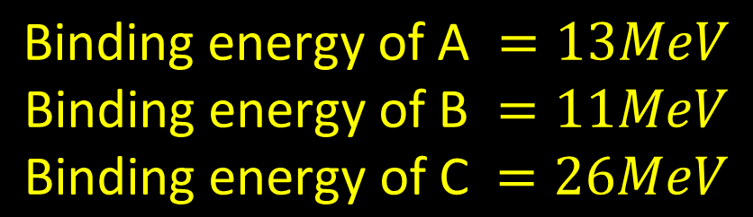



Question
Find energy emitted in the reaction
$$A+B→C$$
$$\text{Binding} \text{energy} \text{of} \text{A} =13MeV$$
$$\text{Binding} \text{energy} \text{of} \text{B} =11MeV$$
$$\text{Binding} \text{energy} \text{of} \text{C} =26MeV$$
Solution
$$Energy→$$
$$2MeV$$

Slide 14



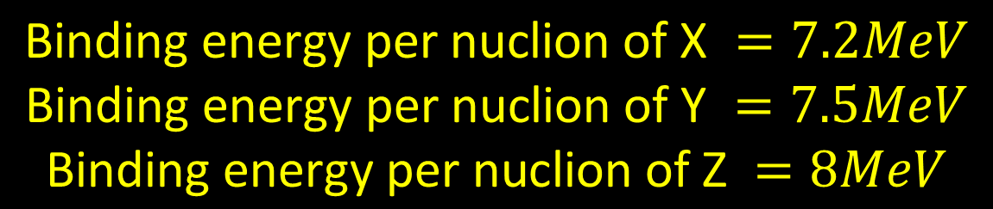












Question
Find energy emitted in the reaction
$${}_{2}^{5}X+{}_{3}^{8}Y→{}_{5}^{13}Z$$
$$\text{Binding} \text{energy} \text{per} \text{nuclion} \text{of} \text{X} =7.2MeV$$
$$\text{Binding} \text{energy} \text{per} \text{nuclion} \text{of} \text{Y} =7.5MeV$$
$$\text{Binding} \text{energy} \text{per} \text{nuclion} \text{of} \text{Z} =8MeV$$
Solution
$$13×8$$
$$−$$
$$5×7.2$$
$$+$$
$$8×7.5$$
$$=$$
$$8MeV$$
Or with reference 7.2MeV
$$13×0.8$$
$$−$$
$$5×0$$
$$+$$
$$8×0.3$$
$$=$$
$$8MeV$$

Slide 15


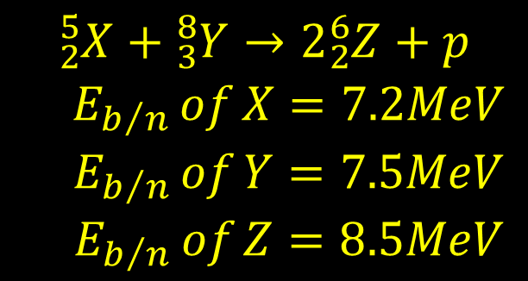





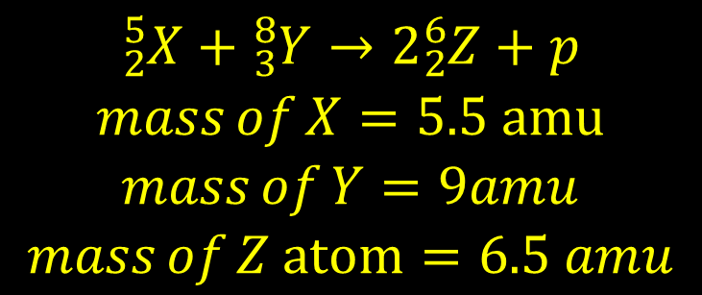






Question
Question
Find energy emitted in the reaction
Find energy emitted in the reaction
$$\begin{matrix}{}_{2}^{5}X+{}_{3}^{8}Y→2{}_{2}^{6}Z+p \\ E_{b/n} of X=7.2MeV \\ E_{b/n} of Y=7.5MeV \\ E_{b/n} of Z=8.5MeV\end{matrix}$$
$$\begin{matrix}{}_{2}^{5}X+{}_{3}^{8}Y→2{}_{2}^{6}Z+p \\ mass of X=5.5 amu \\ mass of Y=9amu \\ mass of Z atom=6.5 amu\end{matrix}$$
$$Sol⇒$$
$$2×$$
$$6×8.5$$
$$−$$
$$5×7.2$$
$$+$$
$$8×7.5$$
$$Sol⇒$$
($5.5+$
$$9$$
$$−1$$
$$)×931$$
$$−13$$

Slide 16
Note:-
Binding energy of hydrogen atom/Single proton/Single neutron
0
Mass of hydrogen atom/Single proton/Single neutron
1 amu

Slide 17
Discussion on stability

Slide 18



$m_{He}=$4.0026 u
M-A/A
$m_{O}=$15.999 u
$m_{c12}=$12 u
Packing fraction
Can be positive negative or zero
Packing fraction is zero for C₁₂
Smaller Packing fraction mean more stable

Slide 19
N
Neutron rich
Stability requires the ratio of neutron to proton to be around 1:1 for light nuclei. This ratio increases to about 3:2 for heavy nuclei.
Neutron poor
Reason
As nuclear force is short range force we need more neutron to overcome proton repulsive force
Stability curve
Z
All particle on this curve are stable
It help to find what is type of instability exist in element

Slide 20
Binding energy per nucleon

Slide 21
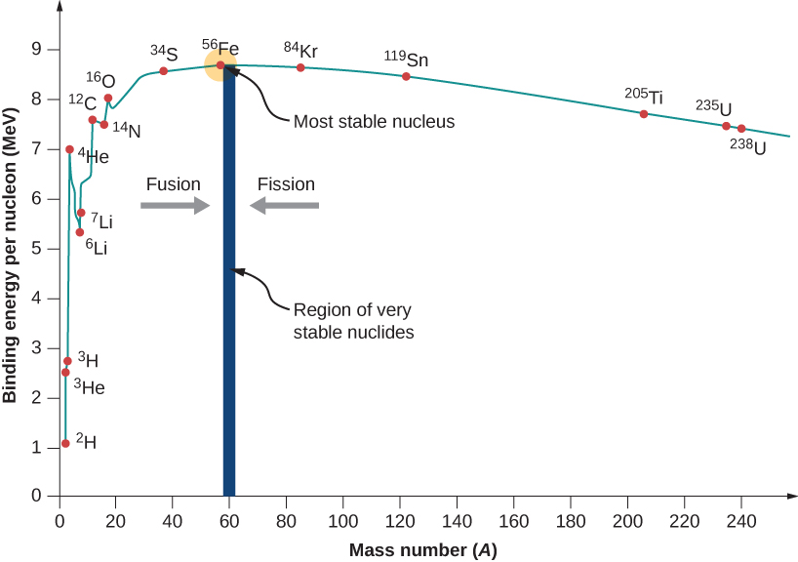

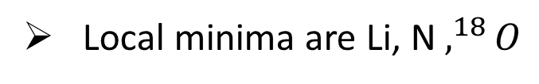
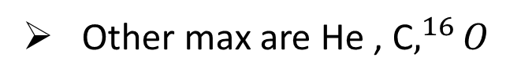

Below 56
Above 56
$$Try to Combine$$
$$Try to break$$
Hydrogen B.E. can be taken as zero
Maximum for Fe(56)
Other max are He , C$,^{16}O$
Local minima are Li, N $,^{18}O$

Slide 22




Below 56
Above 56
$$Try to Combine$$
$$Try to break$$
Hydrogen B.E. can be taken as zero
Maximum for Fe(56)
Other max are He , C$,^{16}O$
Local minima are Li, N $,^{18}O$

Slide 23
Radioactive material and radioactivity

Slide 24
Radioactivity is the property of matter where an unstable atom spontaneously releases energy and particles (radiation) to become more stable. Radioactive material is the substance itself, a solid, liquid, or gas, that contains these unstable atoms and emits this radiation

Slide 25
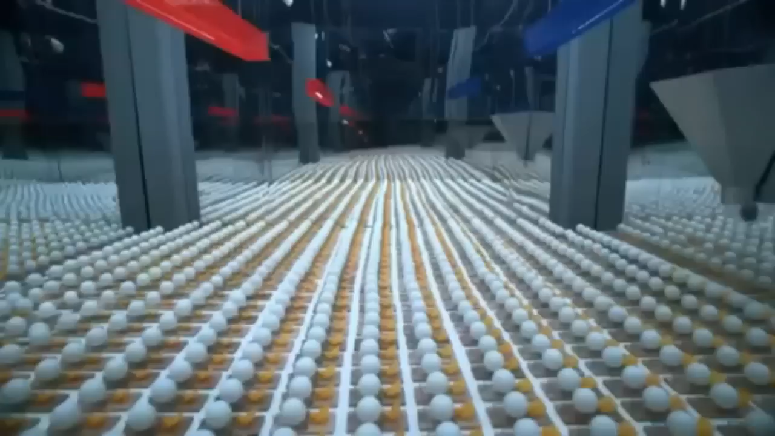
Chain Reaction

Slide 26



Reproduction factor
$$=\frac{nutron created}{nutron absorbed}$$
$$≈2.5$$
Energy released from one atom
$$=200MeV$$

Slide 28
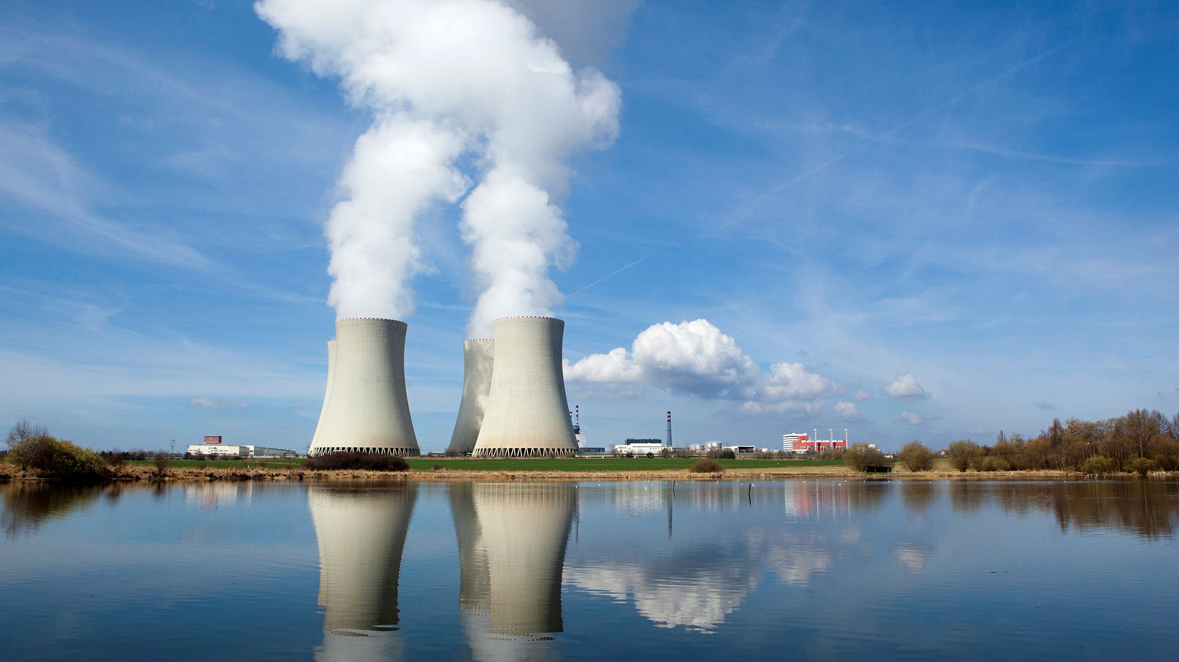
Nuclear reactor
VS
Nuclear BOMB

Slide 29
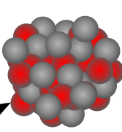

Neutron
It emit more than 1 neutron which are fast.
X
Fast or slow
Use Control rod like Cadmium to Absorb extra neutron
To reduce speed these neutron collide with moderator like
Moderator are light or heavy mass
X
$$D_{2}O,H_{2}O,graphite$$

Slide 30
Below 56
Above 56
$$Try to Combine$$
$$Try to break$$
Hydrogen B.E. can be taken as zero
Maximum for Fe(56)
Other max are He , C$,^{16}O$
Local minima are Li, N $,^{18}O$

Slide 31
Below 56
Above 56
$$Try to Combine$$
$$Try to break$$
Hydrogen B.E. can be taken as zero
Maximum for Fe(56)
Other max are He , C$,^{16}O$
Local minima are Li, N $,^{18}O$

Slide 32
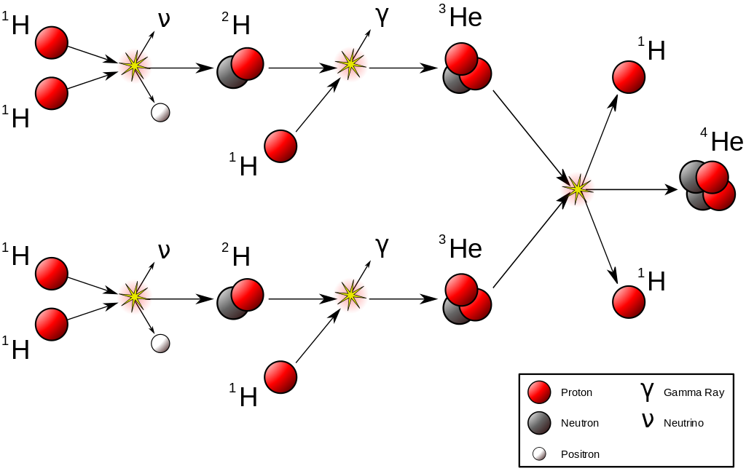
Nuclear fusion
26.7MeV
$$26.7MeV for 4 hydrogen forming He$$

Slide 33

Nuclear fusion
Need to overcome Columbian barrier
For that it need high energy which come from temperature
$400KeV$ energy is required so temperature required is $3×109$
No device gets controlled net positive fusion reaction (tokamak, ICF)

Slide 34
NCERT EXTRA Point’s
Reason
Mass-energy interconversion takes place only in nuclear reaction and never in chemical reaction. This is strictly speaking, incorrect.
Energy and mass are representing same physical quantity

Slide 35
NCERT EXTRA Point’s
Reason
Although the binding energy (per nucleon) curve is smooth and slowly varying.
As nuclear force is short range force number of interaction with each added nucleon remain same

Slide 36
NCERT EXTRA Point’s
Reason
Binding energy shows peaks at nuclides like 4He, 16O etc.
This is considered as evidence of atom-like shell structure in nuclei.

Slide 37

The age of the sun is about $5×{10}^{9}$ year and it is estimated that there is enough hydrogen in the sun to keep it going for another 5 billion years. After that, the hydrogen burning will stop and the sun will begin to cool and will start to collapse under gravity, which will raise the core temperature. The outer envelope of the sun will expand, turning it into the so called red giant.

Slide 38

Helium is not the only element that can be synthesized in the interior of a star. As the hydrogen in the core gets depleted and becomes helium, the core starts to cool. The star begins to collapse under its own gravity which increases the temperature of the core. If this temperature increases to about ${10}^{8}$ K, fusion takes place again, this time of helium nuclei into carbon. This kind of process can generate through fusion higher and higher mass number elements.

Slide 39

13.7.3 Controlled thermonuclear fusion
The natural thermonuclear fusion process in a star is replicated in a thermonuclear fusion device. In controlled fusion reactors, the aim is to generate steady power by heating the nuclear fuel to a temperature in the range of ${10}^{8}$ K. At these temperatures, the fuel is a mixture of positive ions and electrons (plasma). The challenge is to confine this plasma, since no container can stand such a high temperature. Several countries around the world including India are developing techniques in this connection. If successful, fusion reactors will hopefully supply almost unlimited power to humanity.

Slide 40
Nuclear Decay

Slide 41





Nuclear Decay
Alpha
Beta
Gamma
Beta -ve
Beta +ve
Electron capture
Emit$e_{2}^{4}He$
Emit$e_{−1}^{0}e$
Emit $e_{1}^{0}e$
Capture $e_{−1}^{0}e$
Emit $γ$

Slide 42






Question
$$α$$
$$β$$
$$β−$$
$$β+$$
$$α$$
$$e_{50}^{124}X$$
Solution

Slide 43


Question
How many alpha particle and beta particle are emitted here
$$e_{50}^{124}X$$
$$e_{43}^{104}X$$
Solution

